Slide 1
Redfin WebScraping & Analysis

Slide 2
Agenda
Company & Reason
Redfin Background & Project Objectives
Scraping Methodology
What information to scrape
Tools
Analysis & Visualization
Code & Our data story
Conclusion
Data driven conclusion & challenges

Slide 3
Company & Reason

Slide 4

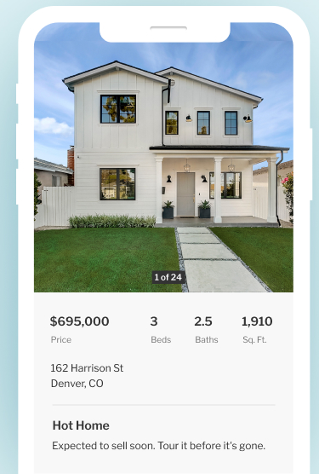
Company: Redfin
Background
Redfin is a real estate brokerage company founded in 2004 in Seattle, Washington.
Over 80 markets in the United States and Canada.
Mission: make the process of buying or selling a home as efficient and seamless as possible.
Services
Real estate listings, home search tools, home value estimates, and a network of local real estate agents.
Using technology and charging a lower commission fee.
Notes:
Redfin is a real estate brokerage company founded in 2004 in Seattle, Washington.
Operates in over 80 markets in the United States and Canada.
Mission is to make the process of buying or selling a home as efficient and seamless as possible.
Offers a variety of services including real estate listings, home search tools, home value estimates, and a network of local real estate agents.
Differentiates itself from traditional real estate brokerages by using technology and charging a lower commission fee.
Has received recognition for its innovative approach to the real estate industry.
Went public in 2017 and has continued to grow and expand its services.

Slide 5

Reason & Objective
Reason:
The integration of new technologies into the home-buying process is an interesting development.
The accuracy and timeliness of the information provided on the platform
Data plays a significant role in the real estate industry.
Objective:
Find out the prices of different types of homes in metro cities (Vancouver, BC or Toronto, ON)
What type of property is being sold?
Notes:
Redfin is a platform that offers home-buying insights to the general public. The integration of innovative technology into the home-buying process is a noteworthy development. The accuracy and timeliness of the information provided on the platform is crucial for maintaining a favorable customer experience, as data plays a significant role in the real estate industry.

Slide 6
Scraping Methodology

Slide 7

Methodology
Our technique:
Python as main language
BeautifulSoup and Selenium to scrape the data
Clean: use Excel
Matplotlib, Seaborn & PowerBI to visualize
Notes:
We are going to use Python as our programming language combining the BeautifulSoup package and Selenium to scrape data from Zillow.com.

Slide 8
Analysis & Visualization

Slide 9
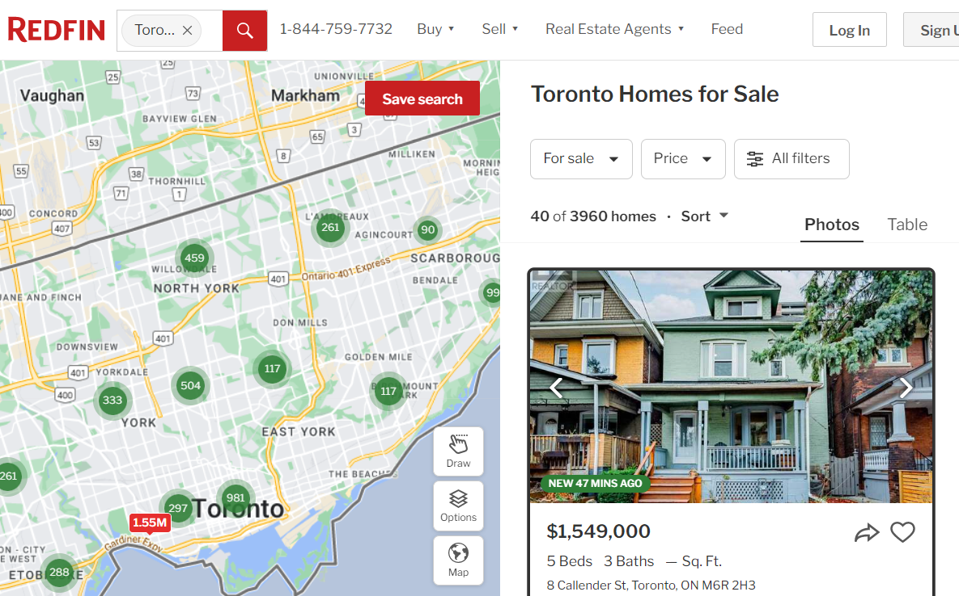
Briefing - without sign in
What info to scrape:
Price
Address
Features, sqft
Notes:
Before coding part, let’s mention a little bit about the website, if you’re just a random user of the website, or non-registered user, after you search the location of the property, you can see the images of the property, the listing price, addresses, square footage, some features of the properties, like how many bedrooms, bathrooms

Slide 10
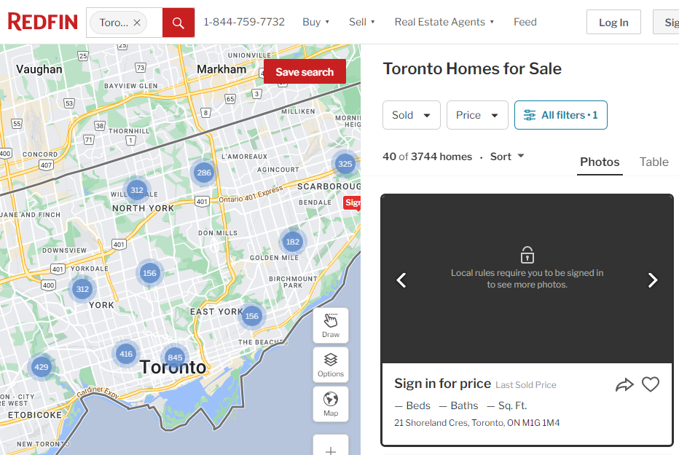
Briefing - Sold property
What info to scrape:
Price
Address
Features, sqft
Time Sold (within 1 year)
Notes:
I’m also interested in the sold property and the information it gives, after filtered to only sold property, it requires using login credentials to login the page, it is a useful spot to use Selenium to input my own credential before using beautiful soup to parse the html

Slide 11
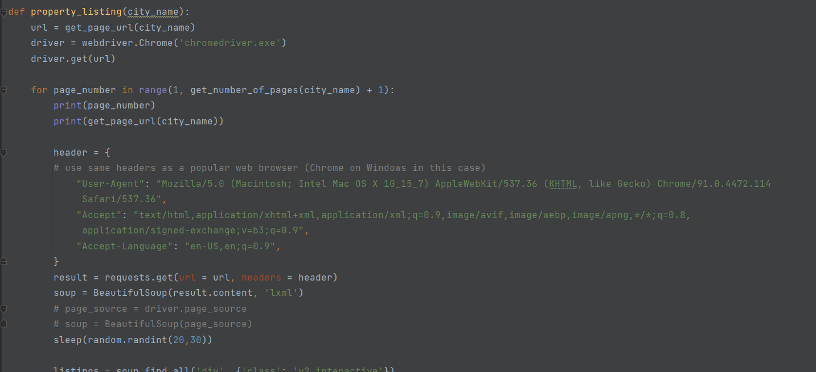
Code - current available listing
Notes:
2 main parts of the code: where I will extract the current available listings and 1 part I have to use selenium to navigate and input credentials

Slide 12
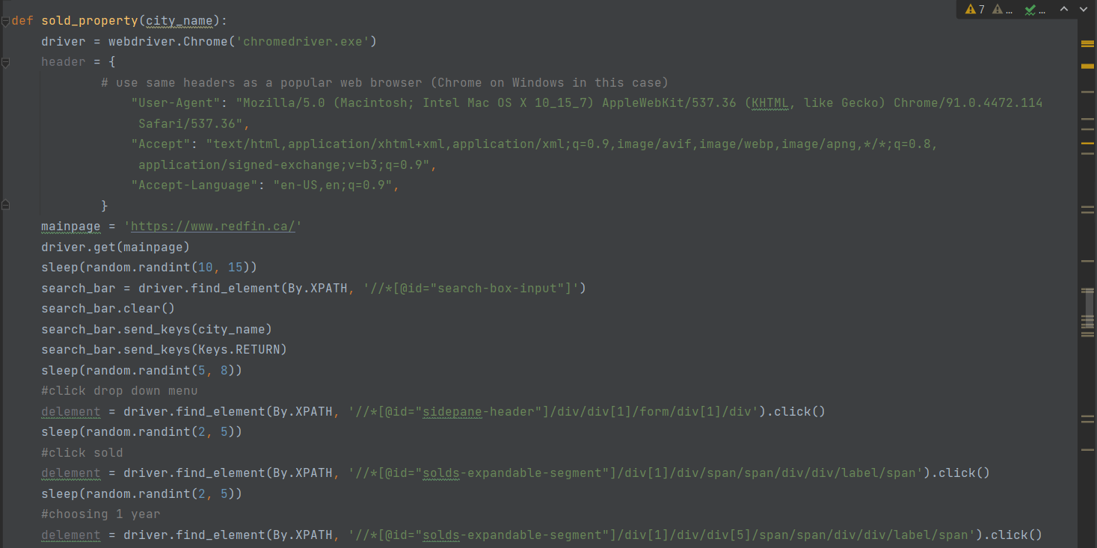
Code - for sold property
Notes:
2 main parts of the code: where I will extract the current available listings and 1 part I have to use selenium to navigate and input credentials

Slide 13

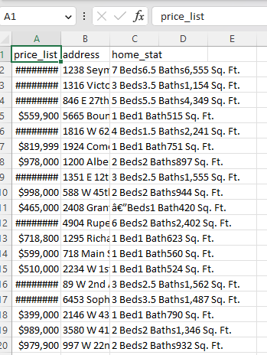
Raw Data - Listings
Output
2 files as output of scraping
data_Vancouver
data_sold_property_Vancouver
(1 extra file: data_Toronto)
Records: 4869
Notes:
Why there is a different in data -> I will mention it in the challenges part

Slide 14
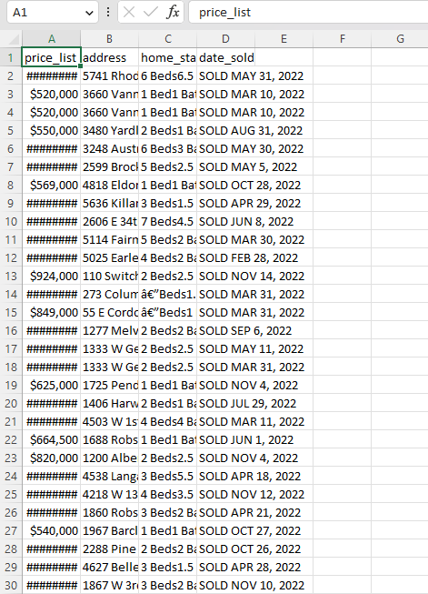
Raw Data - Sold Property
Output
data_sold_property_Vancouver
Records: 1145
Notes:
Why there is a different in data -> I will mention it in the challenges part

Slide 15
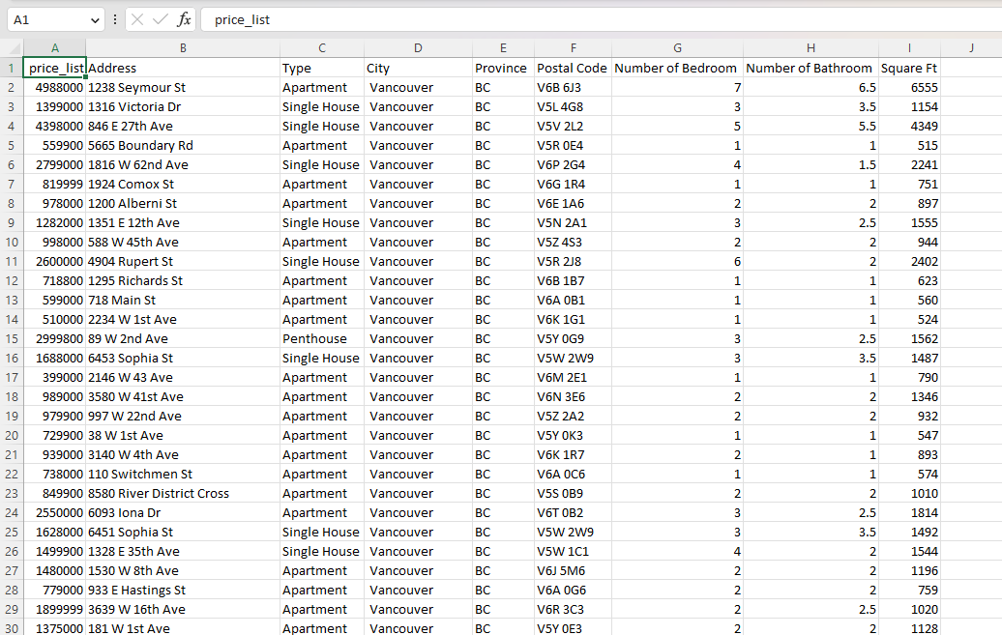
Cleaned Data - Listings
Output
9 Columns (data_Vancouver)
4699/4869, 170 can’t encoded

Slide 16
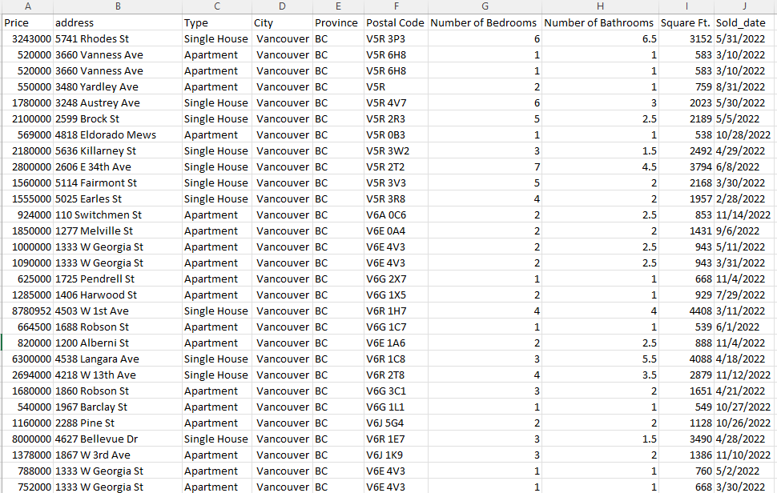
Cleaned Data - Sold Property
Output
10 Columns (data_sold_property_Vancouver)
1100/1145, 45 can’t encoded

Slide 17
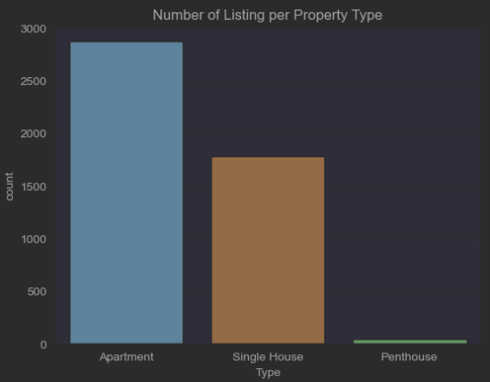
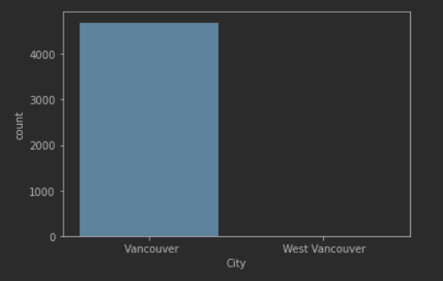
Visualization - Listings

Slide 18
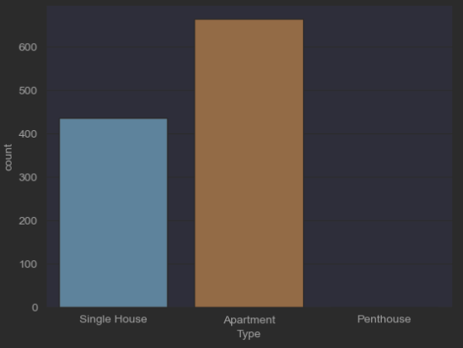
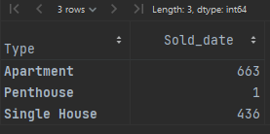
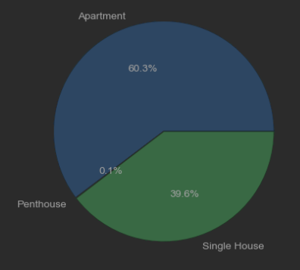
Visualization - Sold Property
Notes:
Apartment: 663, Single house: 436, 1 penhouse

Slide 19
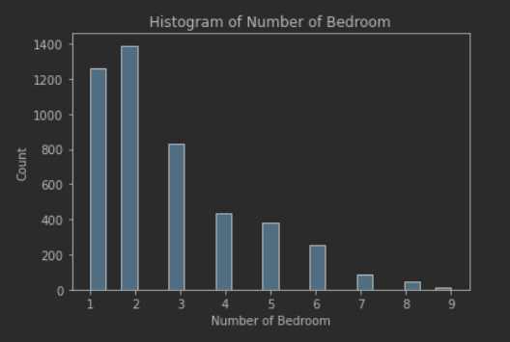
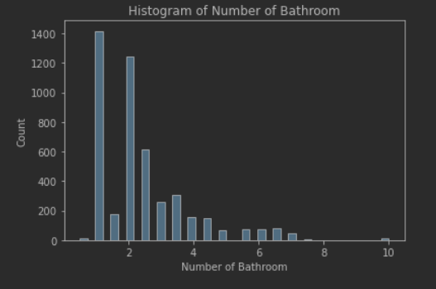
Visualization - House Features

Slide 20
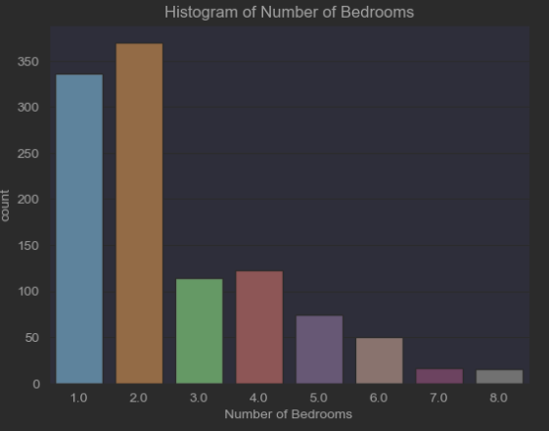
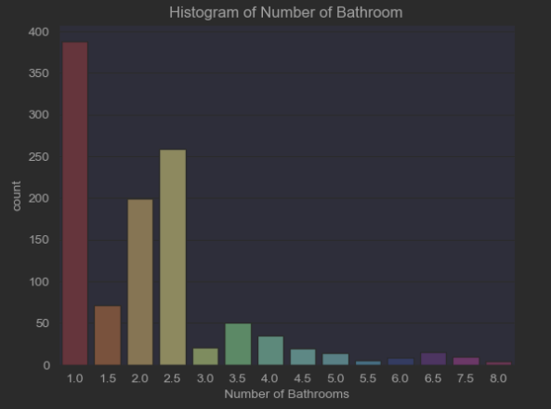
Visualization - Sold House Features

Slide 21
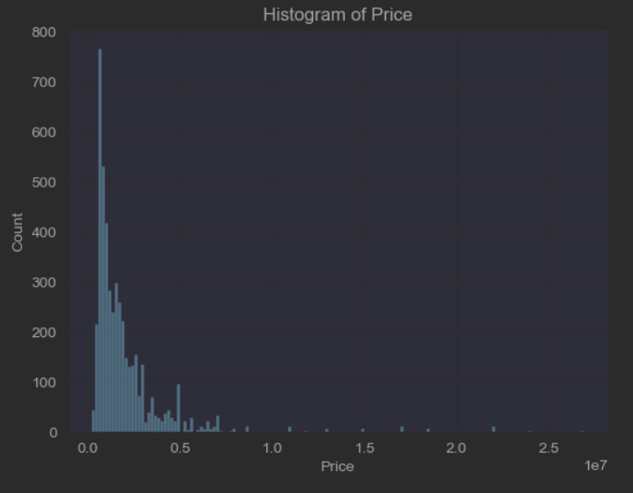
Visualization - House Price
Overall:
$ 1-2 million
Note: 1e7 = 10^7

Slide 22
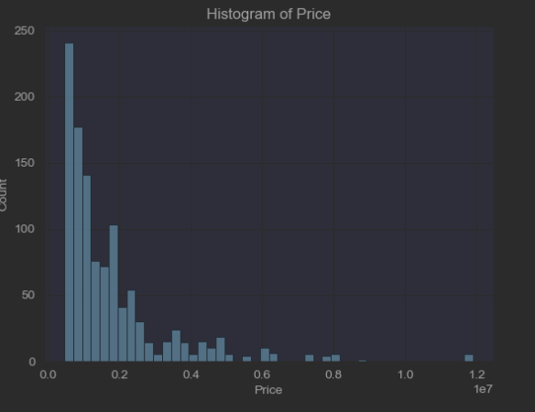
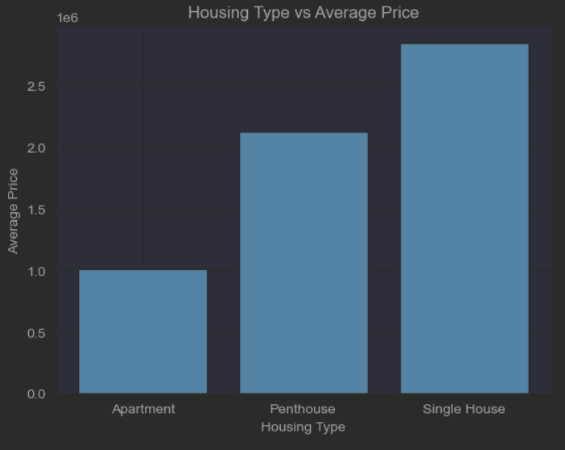
Visualization - Sold House Price
Overall:
$1 mil
Note: 1e7 = 10^7
Notes:
Type
Apartment 1016027.447963801
Penthouse 2125000.000000000
Single House 2842759.029816514

Slide 23
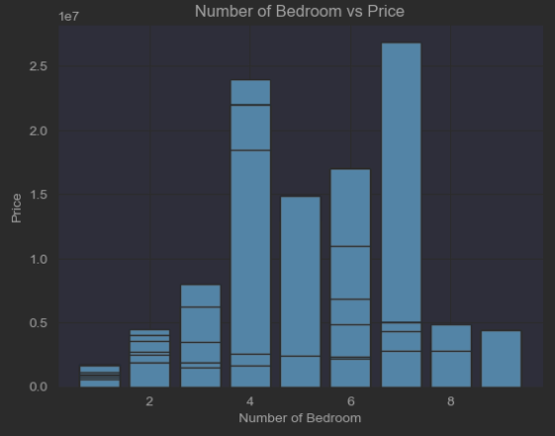
Visualization - Bed & Price
Overall:
Spike in 4 bedroom
6 bedrooms cost the most

Slide 24
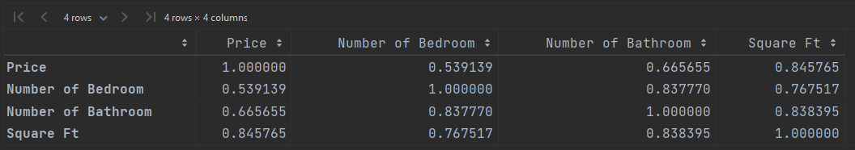
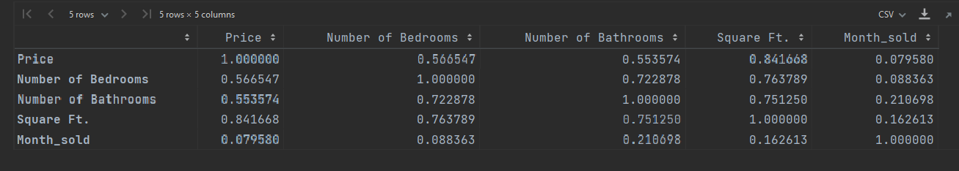
Visualization - Correlation
Correlation (-1 to 1)
Price & Squarefoot
#Bed & #Baths
#Baths & Squarefoot

Slide 25
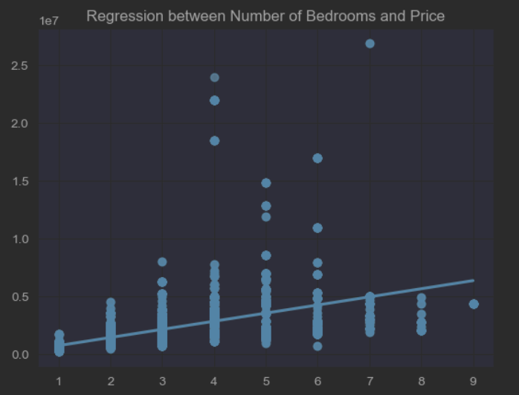
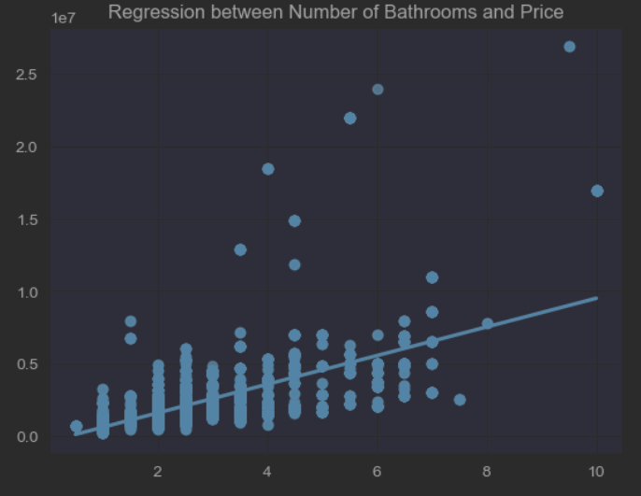
Visualization - Regression

Slide 26
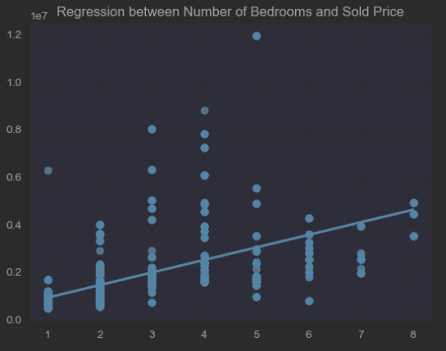
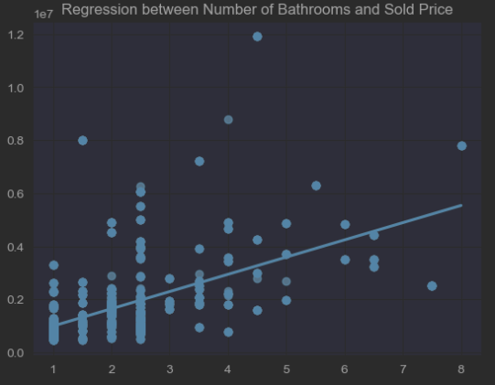
Visualization - Regression

Slide 27
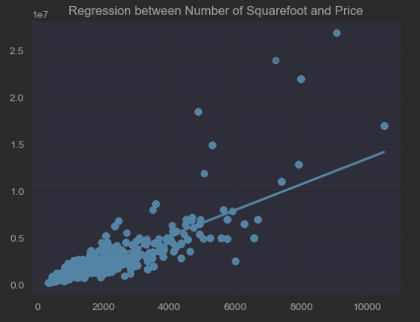
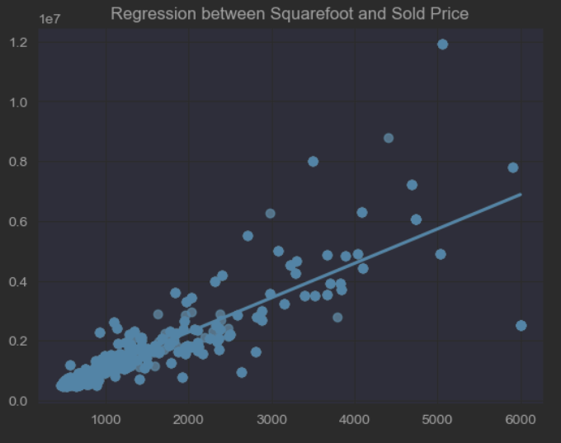
Visualization - Regression
Overall:
Square footage, according to the graph is a stronger predictor to the house price
Positively correlated

Slide 28
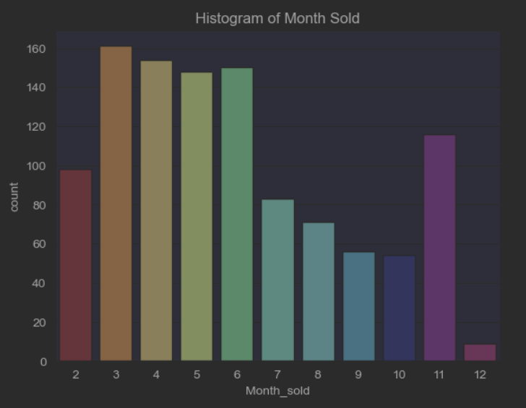
Visualization - Month Sold
Overall:
More house sold between march to june
Spike in November

Slide 29
Conclusion & Challenges

Slide 30
Conclusion
More sqft = More Expensive
Apartment is popular
Most household has 2 beds, 1 bath
People buy home in Summer (March to June) and mid winter (November)

Slide 31

Challenges
Technical (Code)
Code error - For loop - break condition, time, Element cannot found (Button, search_bar), web required bs4 to sign in
Redfin
Limited amount of information (not show all the information), hard to bypass captcha, sign in information
Data
Despite using common encoding scheme (UTF-8), some information is not encoded correctly (e.g. â€) -> missing data, only 1 year
Notes:
Redfin: for 1 instance: there are roughly 8000 homes sold in Vancouver, but there are only 9 pages to navigate on Redfin, each pages contain 40 listings -> 40* 9 = 360 listings, it will random change to some new listings when I refresh the pages as well

Slide 32


What’s next
Data Validation: Validate the data to ensure that it is accurate and complete.
Updating the Scraper: Regularly update the scraper to ensure that it continues to work as websites change over time.
Dashboard: Power BI, Tableau
Notes:
Data Validation: Validate the data to ensure that it is accurate and complete. This could involve checking the data against other sources or conducting further research to verify the information.
Updating the Scraper: Regularly update the scraper to ensure that it continues to work as websites change over time.

Slide 33
Thank You

